Slide 1
History of Database Systems
1950s and early 1960s:
  Data processing using magnetic tapes for storage
    Tapes provide only sequential access
  Punched cards for input
Late 1960s and 1970s:
  Hard disks allow direct access to data
  Network and hierarchical data models in widespread use
  Ted Codd defines the relational data model
    Would win the ACM Turing Award for this work
    IBM Research begins System R prototype
    UC Berkeley begins Ingres prototype
  High-performance (for the era) transaction processing

Slide 2
History (cont.)
1980s:
  Research relational prototypes evolve into commercial systems
    SQL becomes industry standard
  Parallel and distributed database systems
  Object-oriented database systems
1990s:
  Large decision support and data-mining applications
  Large multi-terabyte data warehouses
  Emergence of Web commerce
2000s:
  XML and XQuery standards
  Automated database administration
  Increasing use of highly parallel database systems
  Web-scale distributed data storage systems

Slide 3
Database Design
The process of designing the general structure of the database:
Logical Design – Deciding on the database schema. Database design requires that we find a “good” collection of relation schemas.
  Business decision – What attributes should we record in the database?
  Computer Science decision – What relation schemas should we have and how should the attributes be distributed among the various relation schemas?
Physical Design – Deciding on the physical layout of the database

Slide 4
Data Models
A collection of tools for describing
  Data
  Data relationships
  Data semantics
  Data constraints
Relational model
Entity-Relationship data model (mainly for database design)
Object-based data models (Object-oriented and Object-relational)
Semi structured data model (XML)
Other older models:
  Network model
  Hierarchical model

Slide 5
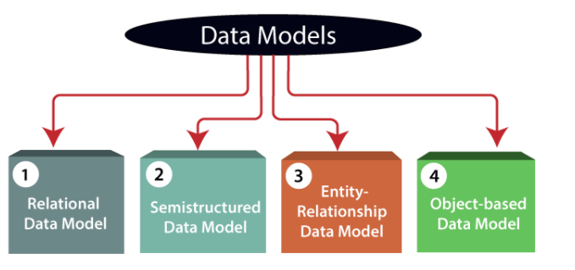

Slide 6
The Relational Model
This type of model designs the data in the form of rows and columns within a table.
Thus, a relational model uses tables for representing data and in-between relationships. Tables are also called relations.
This model was initially described by Edgar F. Codd, in 1969.
The relational data model is the widely used model which is primarily used by commercial data processing applications.

Slide 7


Slide 8

The Entity-Relationship Model
Models an enterprise as a collection of entities and relationships
  Entity: a “thing” or “object” in the enterprise that is distinguishable from other objects
    Described by a set of attributes
  Relationship: an association among several entities
Represented diagrammatically by an entity-relationship diagram:

Slide 9
Object-oriented data model
An extension of the ER model with notions of functions, encapsulation, and object identity, as well.
This model supports a rich type system that includes structured and collection types.
Thus, in 1980s, various database systems following the object-oriented approach were developed.
Here, the objects are nothing but the data carrying its properties.

Slide 10
Object-Relational Data Models
Extend the relational data model by including object orientation and constructs to deal with added data types.
Allow attributes of tuples to have complex types, including non-atomic values such as nested relations.
Preserve relational foundations, in particular the declarative access to data, while extending modeling power.
Provide upward compatibility with existing relational languages.

Slide 11
Semi-structured data
This type of data model is different from the other three data models (explained above).
The semistructured data model allows the data specifications at places where the individual data items of the same type may have different attributes sets.
The Extensible Markup Language, also known as XML, is widely used for representing the semistructured data.
Although XML was initially designed for including the markup information to the text document, it gains importance because of its application in the exchange of data.

Slide 12
XML: Extensible Markup Language
Semi-structured data is the data which does not conforms to a data model but has some structure. It lacks a fixed or rigid schema. It is the data that does not reside in a rational database but that have some organizational properties that make it easier to analyze. With some process, we can store them in the relational database.
Defined by the WWW Consortium (W3C)
Originally intended as a document markup language not a database language
The ability to specify new tags, and to create nested tag structures made XML a great way to exchange data, not just documents
XML has become the basis for all new generation data interchange formats.
A wide variety of tools is available for parsing, browsing and querying XML documents/data

Slide 13
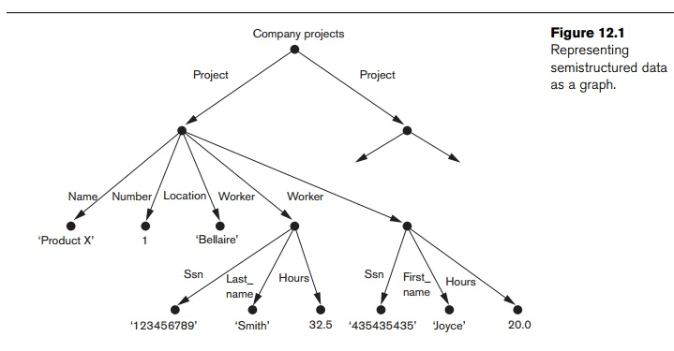
SEMI STRUCTURED DATA

Slide 14
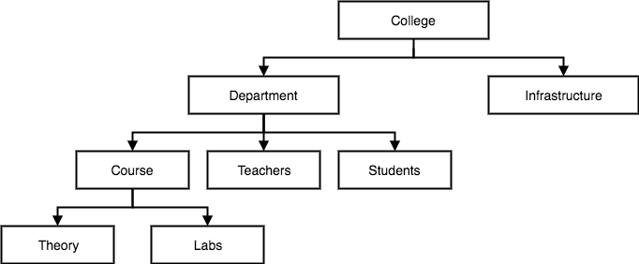
HIERARCHICAL STRUCTURE
This database model organises data into a tree-like-structure, with a single root, to which all the other data is linked.
In this model, a child node will only have a single parent node.
In hierarchical model, data is organised with one one-to-many relationship between two different types of data, for example, one department can have many courses, many professors and of-course many students.

Slide 15
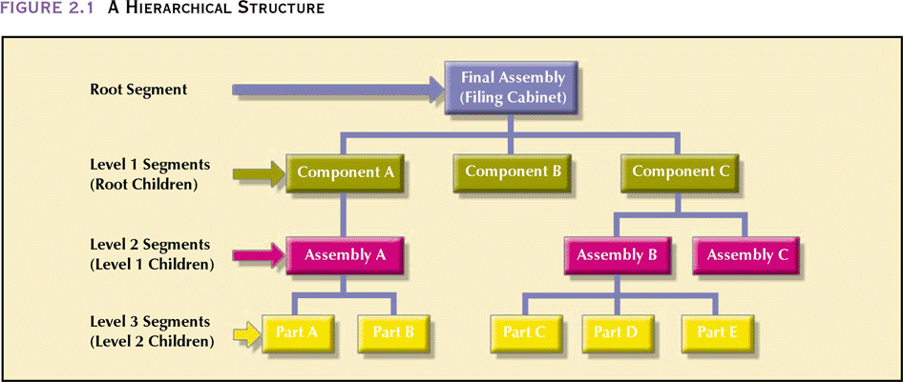
HIERARCHICAL STRUCTURE

Slide 16
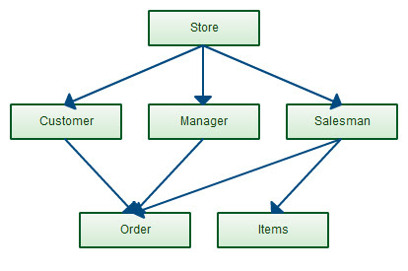
NETWORK MODEL
This is an extension of the Hierarchical model. In this model data is organised more like a graph, and are allowed to have more than one parent node.
In this database model data is more related as more relationships are established in this database model. Also, as the data is more related, hence accessing the data is also easier and fast. This database model was used to map many-to-many data relationships.

Slide 17
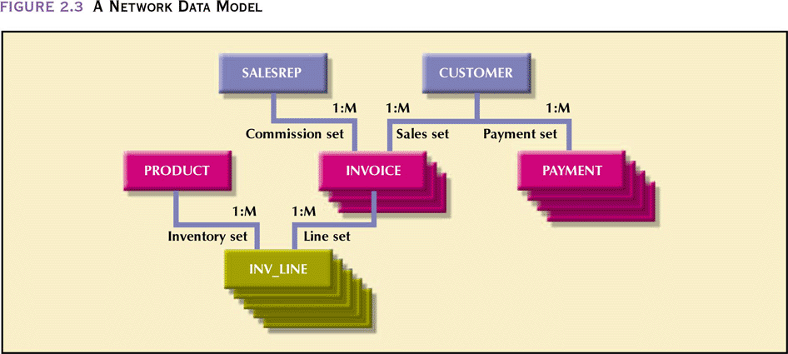
NETWORK MODEL

Slide 18
Database Users
Users are differentiated by the way they expect to interact with
the system
Application programmers – interact with system through DML calls
Sophisticated users – form requests in a database query language
Specialized users – write specialized database applications that do not fit into the traditional data processing framework
Naïve users – invoke one of the permanent application programs that have been written previously
  Examples, people accessing database over the web, bank tellers, clerical staff

Slide 19
Database Administrator
Coordinates all the activities of the database system
  has a good understanding of the enterprise’s information resources and needs.
Database administrator's duties include:
  Storage structure and access method definition
  Schema and physical organization modification
  Granting users authority to access the database
  Backing up data
  Monitoring performance and responding to changes
    Database tuning

